Slide 1


Day : Strings (7-8-2025)
1. Write a program to find the length of a string without using strlen().
Input: Get a string as input
Process: if char is not equal to null then count the length
Output: Print the length
Code:
#include<stdio.h>
int main()
{
int i;
char str1[6]="World",count=0;
for(i=0;i<6;i++)
{
if(str1[i]!='\0')
count++;
}
printf("%d",count);
}
return 0;
Output:

Slide 2

2. Write a program to copy one string to another.
Input: Get a string as input
Process: Equate two strings
Output: Copied string
Code:
#include<stdio.h>
int main()
{
int i;
char str1[6]="World";
char str2[6];
for(i=0;i<6;i++)
{
str2[i]=str1[i];
}
printf("%s",str2);
}
return 0;
Output:

Slide 3
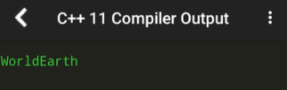
3. Write a program to concatenate two strings.
Input: Get two strings as input
Process: Copy both the string to string 3
Output: Display the string 3
Code:
#include<stdio.h>
int main()
{
int i;
char str1[6]="World";
char str2[6]="Earth";
char str3[12];
for(i=0;i<6;i++)
{
str3[i]=str1[i];
}
printf("%s",str1);
for(i=0;i<6;i++);
{
str3[i]=str2[i];
}
printf("%s",str2);
}
return 0;
Output:

Slide 4
4. Write a program to compare two strings.
Input: Get two strings
Process: Compare the length
Output: Print which is greater
Code:
#include <stdio.h>
int main ()
{
int count1 = 0, count2 = 0, flag = 0, i;
char string1[30], string2[30];
while (string1[count1] != '\0')
count1 ++;
while (string2[count2] != '\0')
count2 ++;
i = 0;
while (string1[i] == string2[i] && string1[i] != '\0')
{
i ++;
}
if (string1[i] > string2[i])
printf ("First string is greater than Second string\n");
else if (string1[i] < string2[i])
else
printf("Second string is greater than First string\n");
printf ("Both strings are EQUAL\n");
}
return 0;
Output:

Slide 5
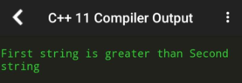

Slide 6
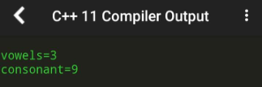
5. Write a program to count vowels and consonants in a string.
Input: Get a string as input
Process:Count the no of vowels and consonants
Output: Print the count
Code:
#include<stdio.h>
int main()
{
int i;
char str1[12]="World earth",vcount=0,ccount=0;
for(i=0;i<12;i++)
{
if(str1[i]=='a'||str1[i]=='e'||str1[i]=='i'||str1[i]=='o'||str1[i]=='u')
vcount++;
else
ccount++;
}
printf("vowels=%d\nconsonant=%d",vcount,ccount);
}
return 0;
Output:

Slide 7
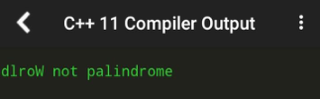
6. Write a program to convert lowercase to uppercase and vice versa.
7. Write a program to check if a string is palindrome.
Input: Get a string as input
Process: Reverse the string to check it's palindrome
Code:
#include<stdio.h>
int main()
{
int i;
char str1[6]="World",flag=0;
char str2[6];
for(i=0;i<6;i++)
{
str2[i]=str1[4-i];
}
for(i=0;i<6;i++)
{
printf("%c",str2[i]);
}
if(str1[i]!=str2[i])
flag=1;
if(flag==0)
printf(" palindrome\n");
else
printf(" not palindrome\n");
}
Output:

Slide 8

8. Write a program to reverse a string.
Input: Get a string as input
Process: Reverse the string
Output: Display the reversed string
Code:
#include<stdio.h>
int main()
{
int i;
char str1[6]="World";
char str2[6];
for(i=0;i<6;i++)
{
str2[i]=str1[4-i];
}
for(i=0;i<6;i++)
{
printf("%c",str2[i]);
}
}
Output:

Slide 9

9. Write a program to count words in a string.
Input: Get a string as input
Process: If string not equal to space count
Output: Print the no of words
Code:
#include<stdio.h>
int main()
{
int i;
char str1[12]="World earth",count=0;
for(i=0;i<12;i++)
{
if(str1[i]==' ')
}
count++;
}
printf("%d",count+1);
Output:

Slide 10
10. Write a program to find the frequency of each character in a string.
Input: Get a string as input
Process: Find the occurrence of the each character in a string
Output: Print the repetition number
Code:
#include<stdio.h>
int main()
{
int a[5]={3,4,5,4,7};
int b[5];
b[0]=a[0];
int flag=0,i,j,k=1;
for(i=0;i<5;i++)
{
flag=0;
for(j=0;j<6;j++)
{
if(a[i]==b[j])
{
flag=1;break;
}
}
if(flag==0)
{
b[k]=a[i];
}
k++;
}
int count=0;
for(i=0;i<k;i++)
{
count=0;
for(j=0;j<5;j++)
{
if(b[i]==a[j])
}
count++;
}
printf("%d-%d\n",b[i],count);

Slide 11
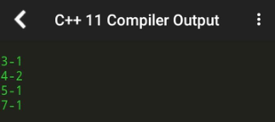
}
Output:

